Slide 1
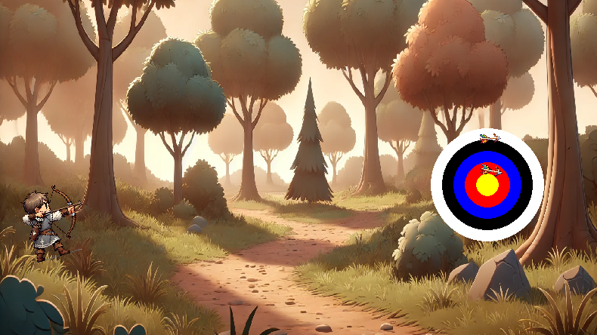
Archery Game
Frederik Simon

Slide 2
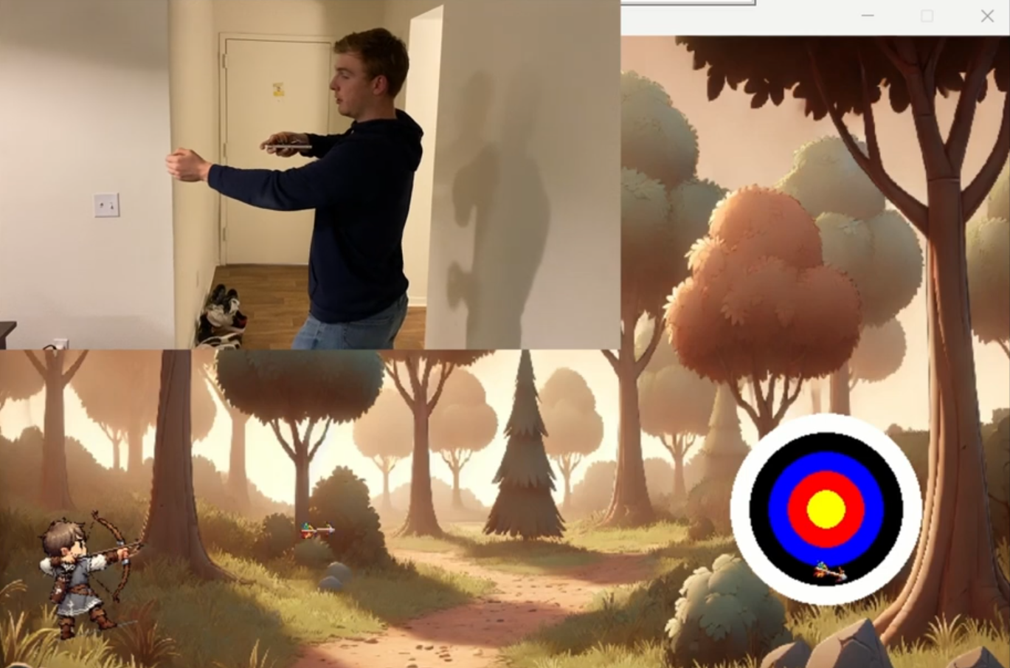
Need of an motion controlled Archery Game
Use Case:
motion controlled games are not accessible on pc
only with expensive equipment or a console
provide a relatively cheap and easy solution to be able to do so
Worth Addressing:
Very popular as Party or Coop games (Wii Sports)
Focus not on fancy features and really good graphics
Focused easy to play and understand

Slide 3
Need of an motion controlled Archery Game
Intended Users:
Families and Party Gamers
compete against your friends and family
Developers and DIY Gamers: add cool features and customize it
Casual Gamers who want to enjoy a motion controlled game

Slide 4
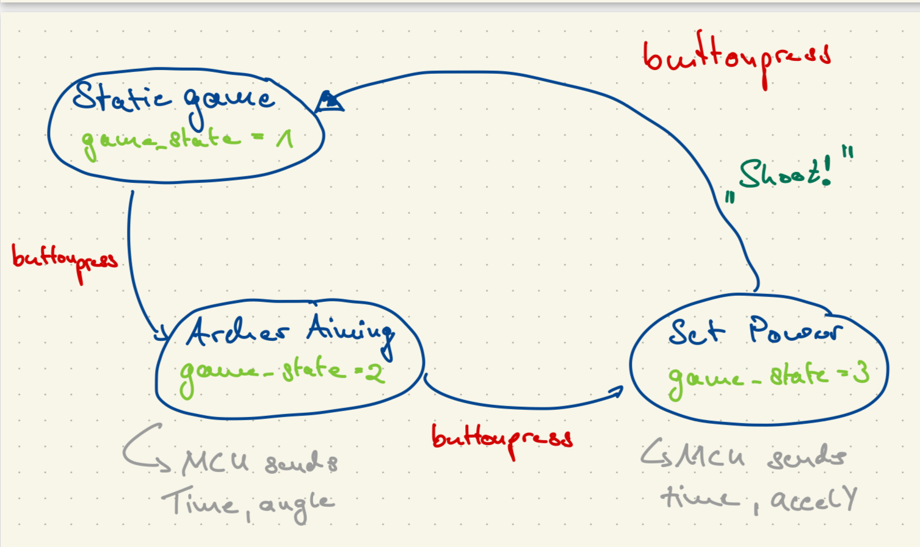
Basic idea

Slide 5

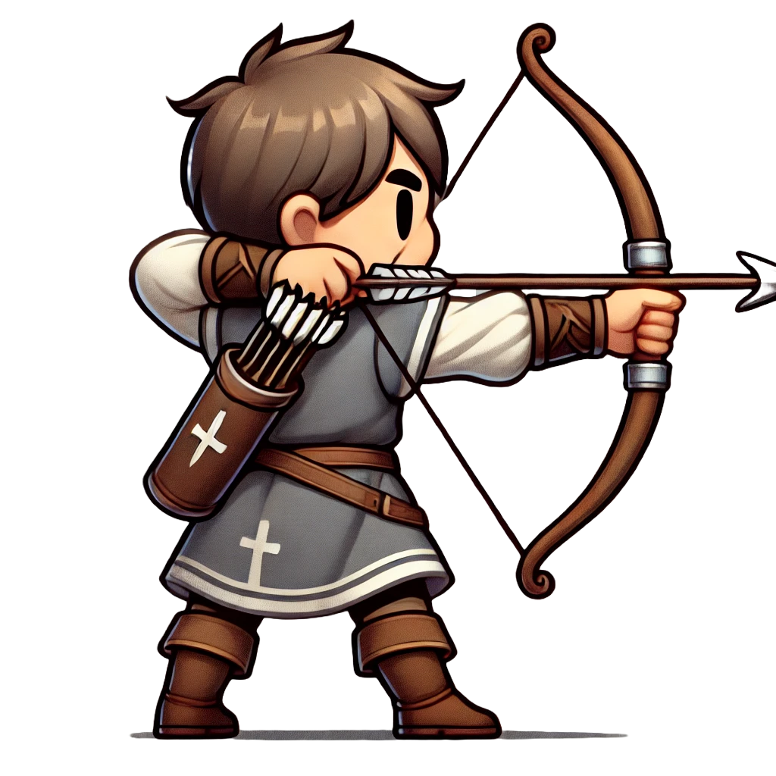
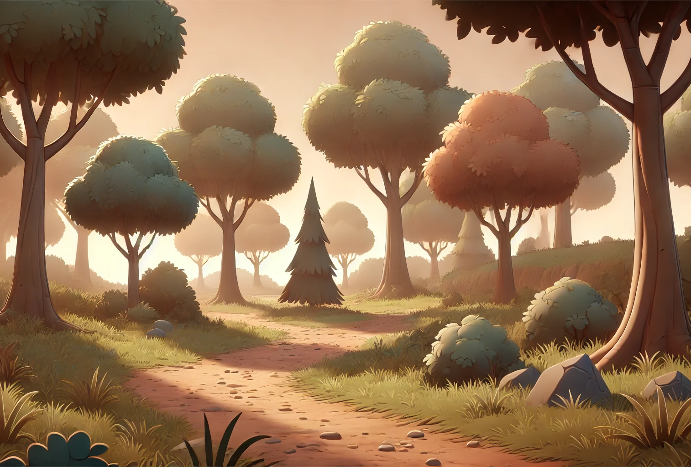
Visuals
Let ChatGPT create cartoon like visuals for backround, archer and arrow
Remove bakround

Slide 6
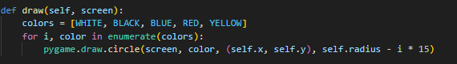
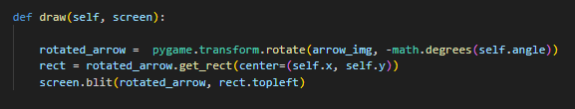
Visuals
Rotate and translate the pictures of archer and arrow depending on their angle and position attributes
Display the rotated pictures
Target: draw concentric circles in different colors

Slide 7
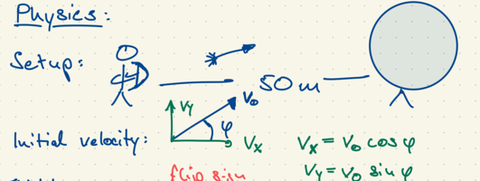
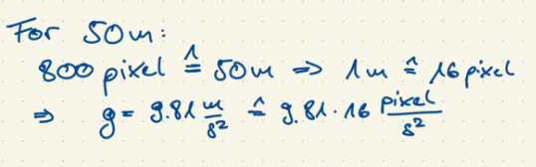
Physics I
Calculate initial velocity
Calculate gravity in pixel/s^2

Slide 8
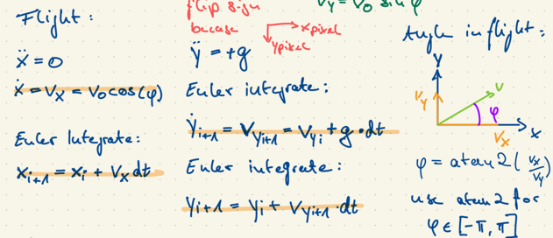
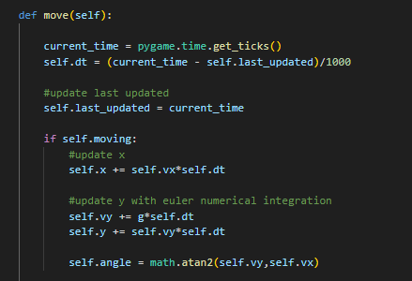
Equations of Motion
Move method of the Arrow class

Slide 9
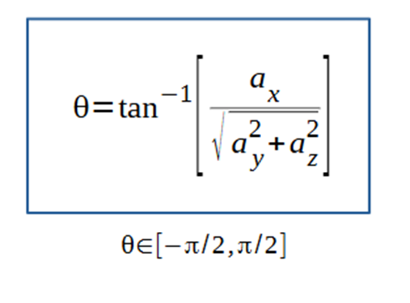
Determine Attitude and Power
Combine acceleration measurements to get roll angle in the IMU frame
Filter accelerometer data and set threshholds that correspond to power states 0-3

Slide 10
Live Demonstration

Slide 11
Adressing the Users Need
Easy Game setup
Minimal equipment
Simple to understand to play
Easy to experiment with new features and improve the game

Slide 12
Possible Improvements
Add a scoring system
Add a shooting animation
Aim just with rotating arm and bow
Game and pause interface

Slide 13
Thank you!

